Slide 1
Mobile Phishing Station
Barış Özbaş

Slide 2
What will I implement?
A Linux command named «bozmitm» (Barış Özbaş Man In The Middle) that perform Man In The Middle Attack (aka MITM) using access point.
Setting up a mobile system using following:
Raspberry pi 3 B+
A wireless adapter to perform the attack.
A power bank to power it

Slide 3
Man In The Middle Attack
In cryptography and computer security, a man-in-the-middle attack (MITM) is an attack where the attacker secretly relays and possibly alters the communication between two parties who believe they are directly communicating with each other.

Slide 4
Example MITM
Alice sends a message to Bob, which is intercepted by Mallory:
Alice "Hi Bob, it's Alice. Give me your key." → Mallory Bob
Mallory relays this message to Bob; Bob cannot tell it is not really from Alice:
Alice Mallory "Hi Bob, it's Alice. Give me your key." → Bob
Bob responds with his encryption key:
Alice Mallory ← [Bob's key] Bob
Mallory replaces Bob's key with her own, and relays this to Alice, claiming that it is Bob's key:
Alice ← [Mallory's key] Mallory Bob
Alice encrypts a message with what she believes to be Bob's key, thinking that only Bob can read it:
Alice "Meet me at the bus stop!" [encrypted with Mallory's key] → Mallory Bob
However, because it was actually encrypted with Mallory's key, Mallory can decrypt it, read it, modify it (if desired), re-encrypt with Bob's key, and forward it to Bob:
Alice Mallory "Meet me at the van down by the river!" [encrypted with Bob's key] → Bob
Bob thinks that this message is a secure communication from Alice.

Slide 5
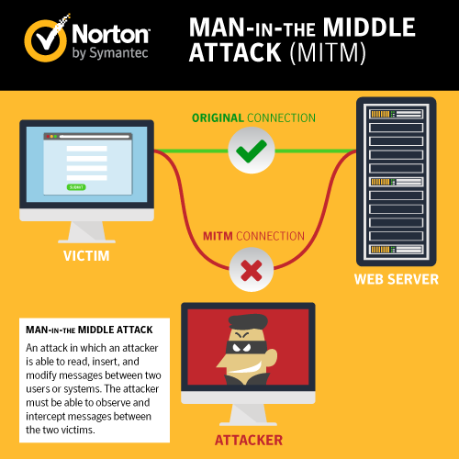
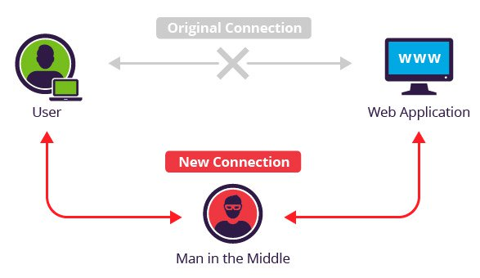

Slide 6
Types of Man-in-the-Middle Attacks
1. Rogue Access Point
Devices equipped with wireless cards will often try to auto connect to the access point that is emitting the strongest signal. Attackers can set up their own wireless access point and trick nearby devices to join its domain. All of the victim’s network traffic can now be manipulated by the attacker. This is dangerous because the attacker does not even have to be on a trusted network to do this the attacker simply needs a close enough physical proximity. «bozmitm» is using this type.
2. ARP Spoofing
ARP spoofing is a type of attack in which a malicious actor sends falsified ARP (Address Resolution Protocol) messages over a local area network. This results in the linking of an attacker's MAC address with the IP address of a legitimate computer or server on the network.

Slide 7
Types of Man-in-the-Middle Attacks
3.DNS Spoofing
Similar to the way ARP resolves IP addresses to MAC addresses on a LAN, DNS resolves domain names to IP addresses. When using a DNS spoofing attack, the attacker attempts to introduce corrupt DNS cache information to a host in an attempt to access another host using their domain name, such as www.onlinebanking.com.

Slide 8
Mobile Phishing Station – «bozmitm»
«bozmitm» uses the first type Rouge Access Point.
For example it will start a wifi hotspot with ssid: "Free Wifi". And some victims in that area may phished. When they start using our free wifi they won’t notice a difference but we will reach their data packets.
After doing first configuration, attacker will leave the mobile phishing station to a place like nero, shopping malls etc. (or even attacker can carry it on backpack while it keeps on working). Any time later, will come back to same place and connect it through ssh, and get the logs to check if it sniffed a valuable data.

Slide 9
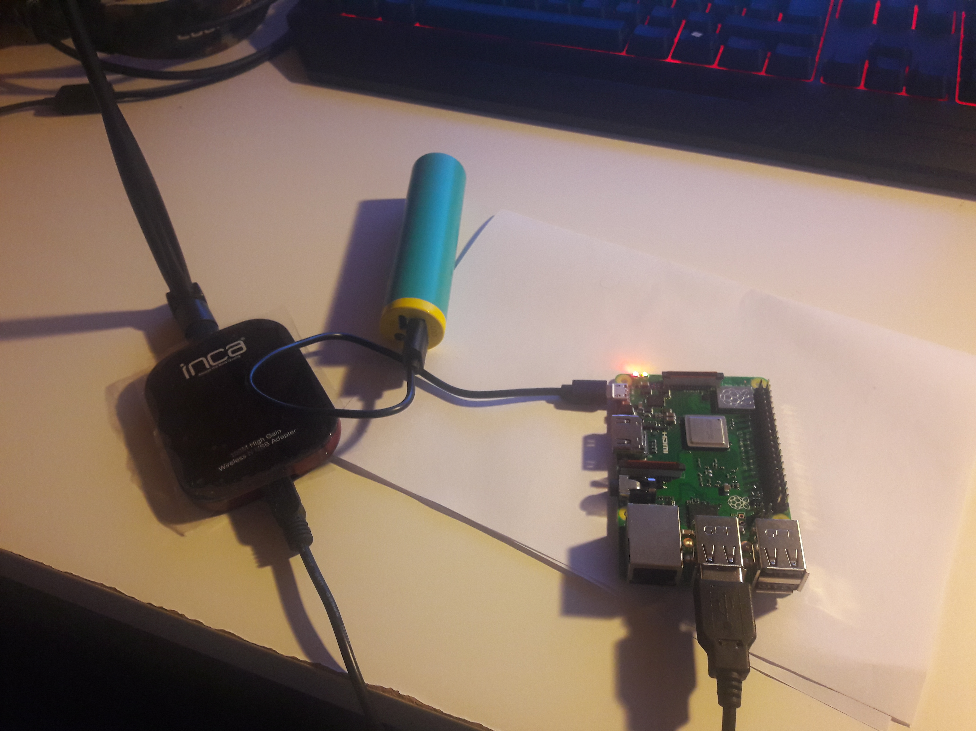
My Setup

Slide 10
What did I use?
Hostapd
Mitmproxy
Tshark
Alias
Xterm
Airmon-ng

Slide 11
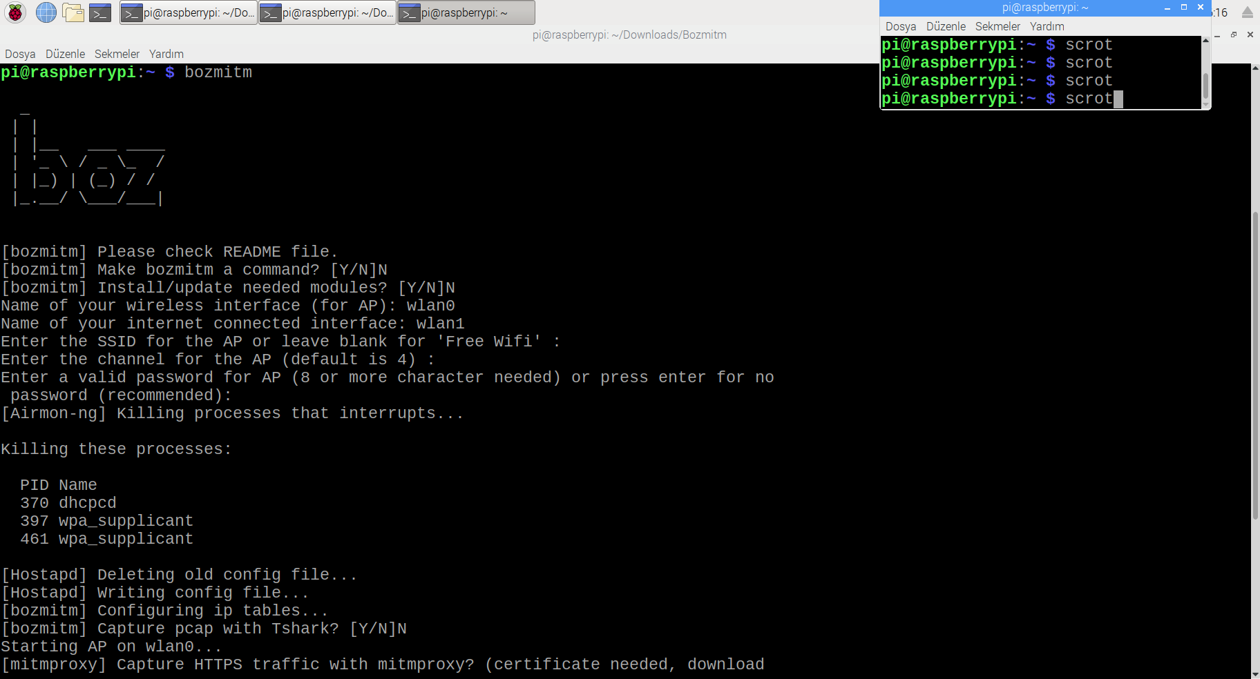
bozmitm

Slide 12
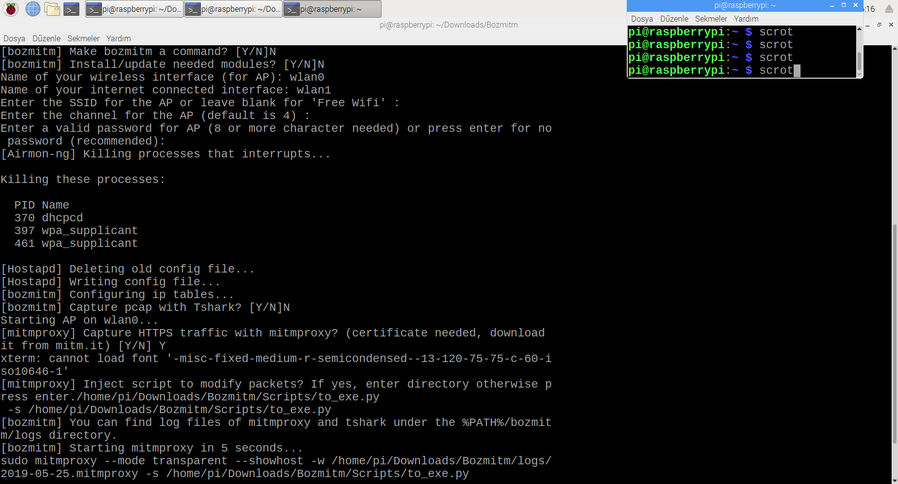

Slide 13
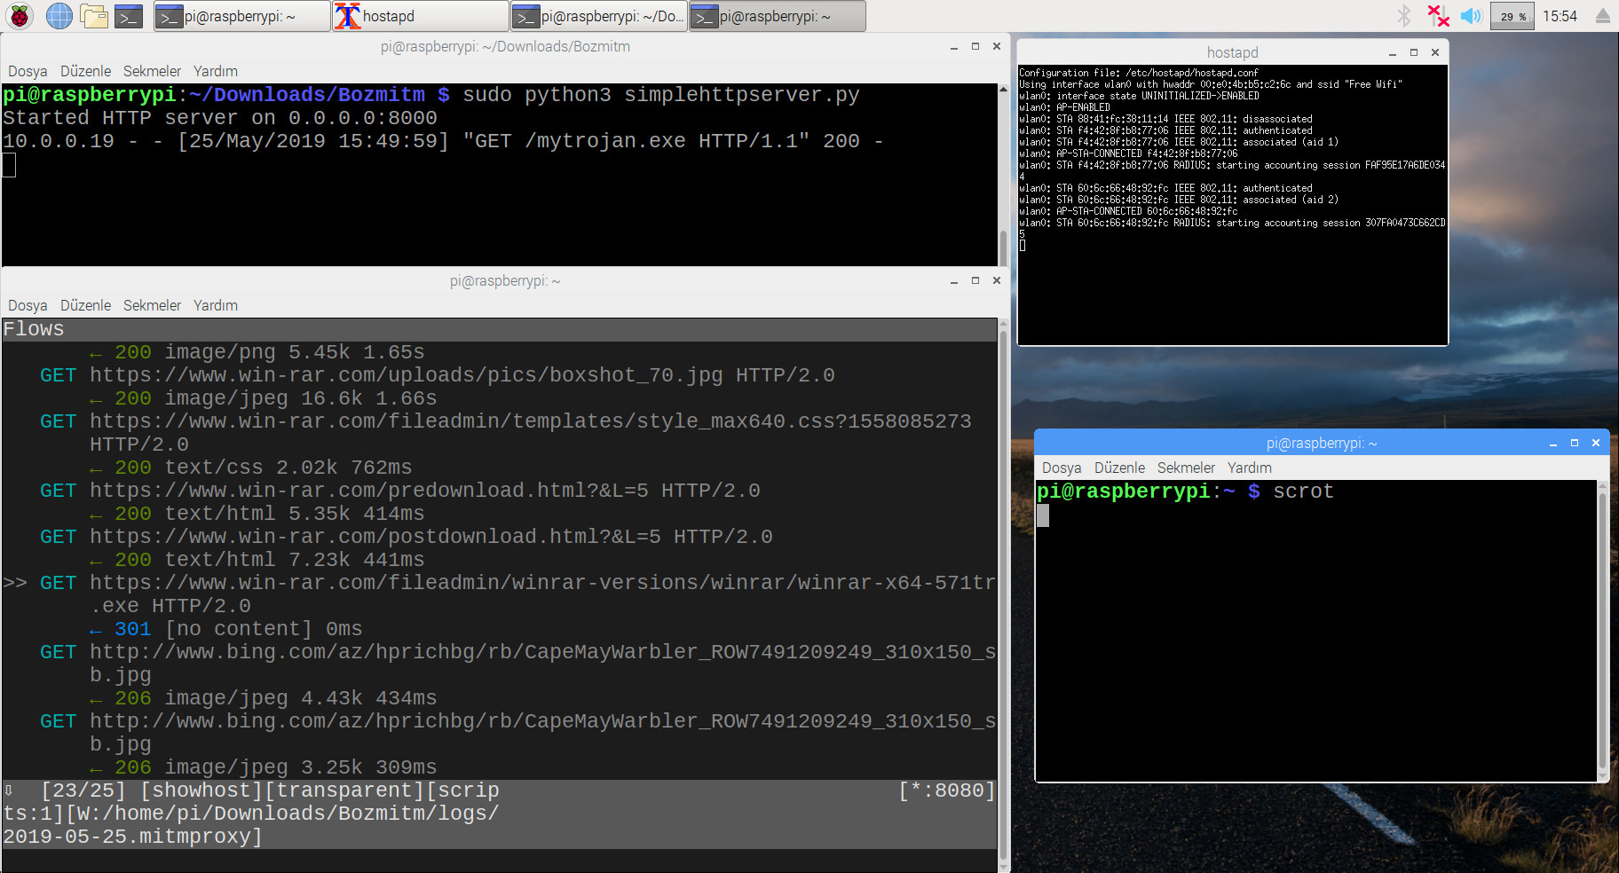
SimpleHTTPserver, to_exe Script

Slide 14
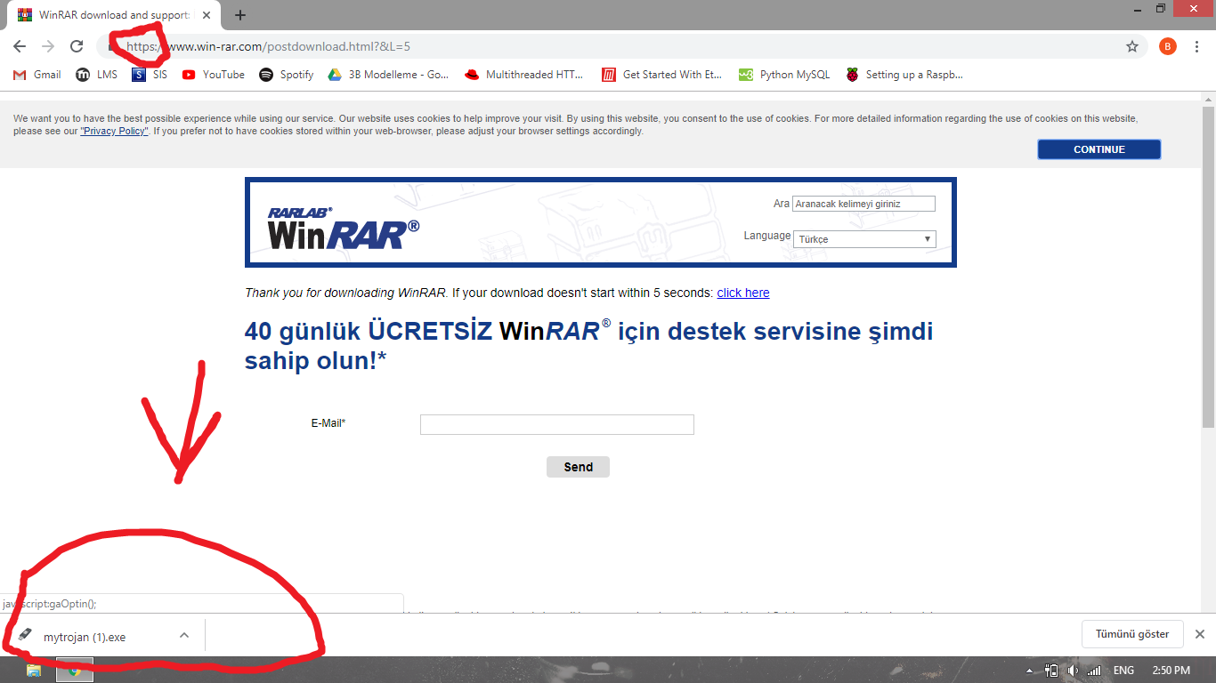

Slide 15
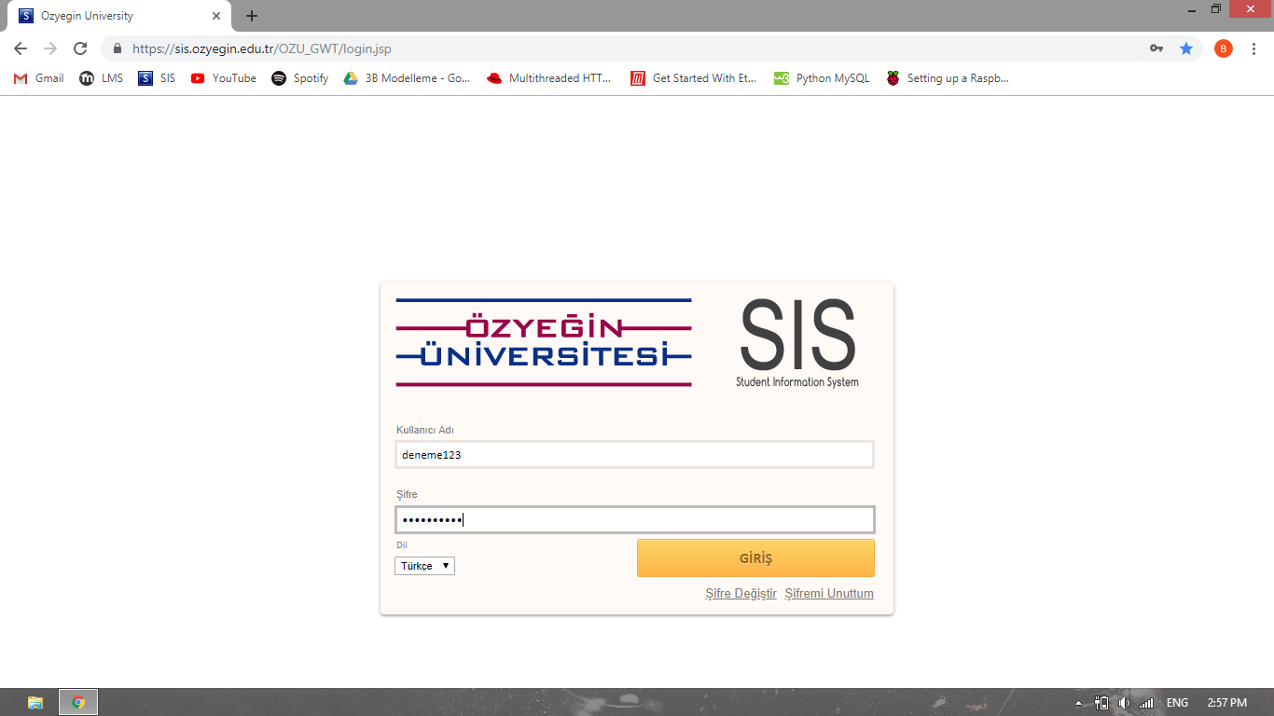
Sis.ozu analysis

Slide 16
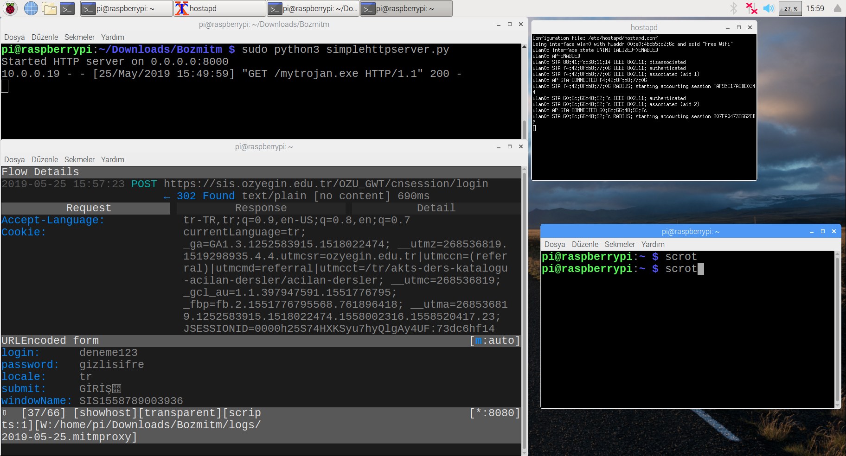

Slide 17
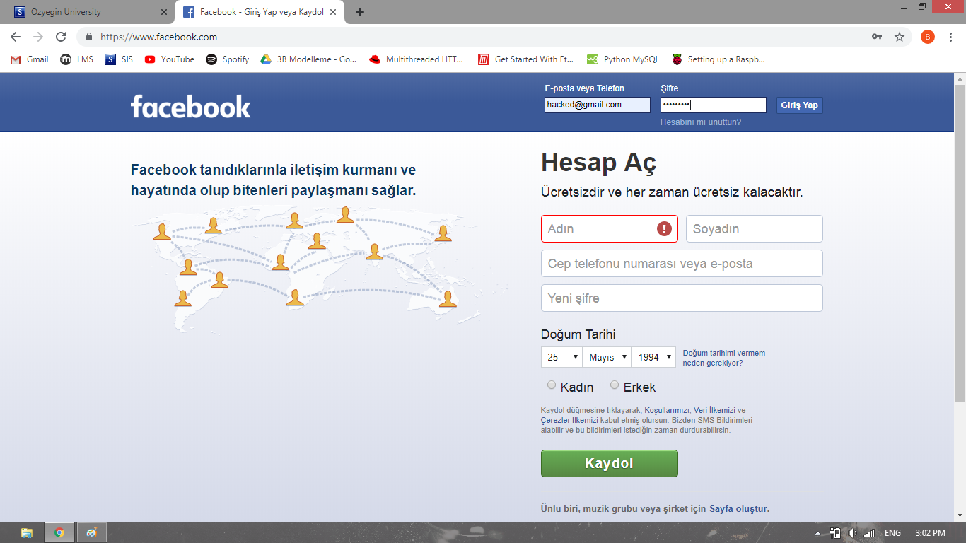
Sis vs Facebook

Slide 18
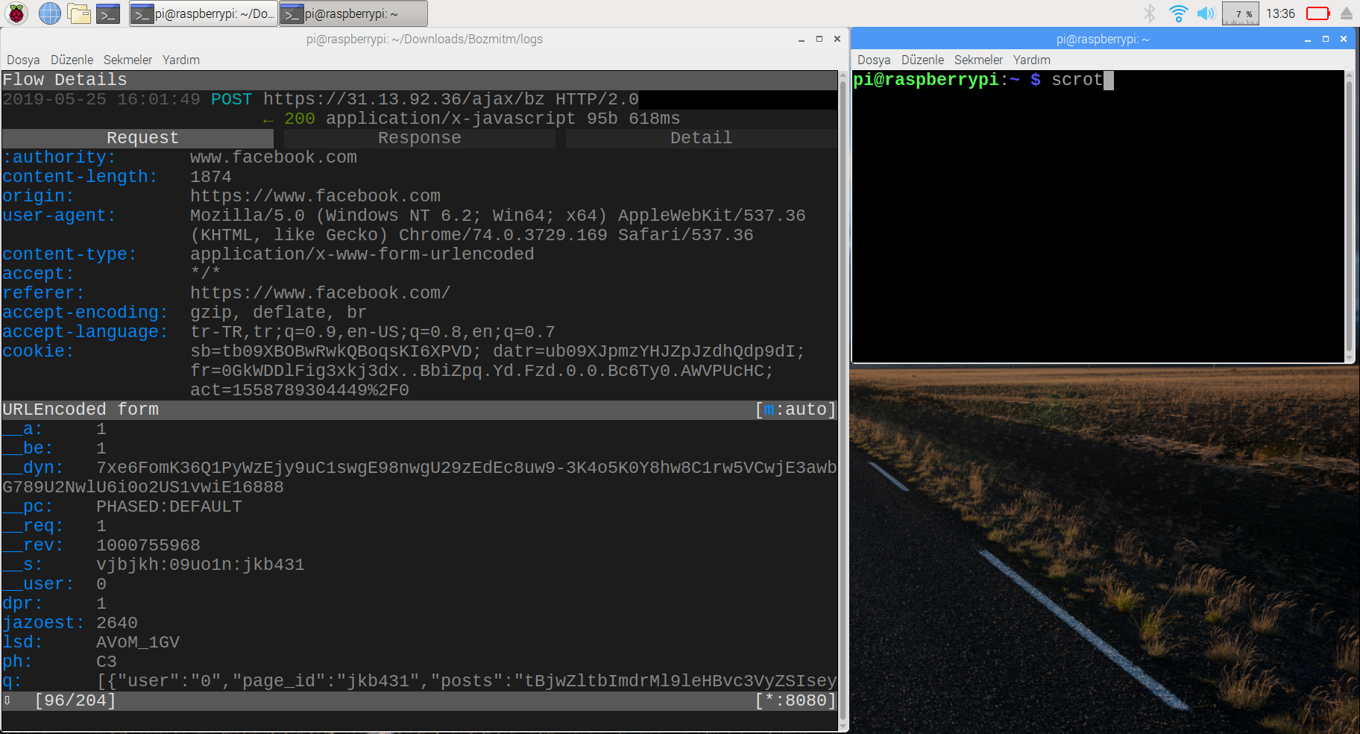

Slide 19
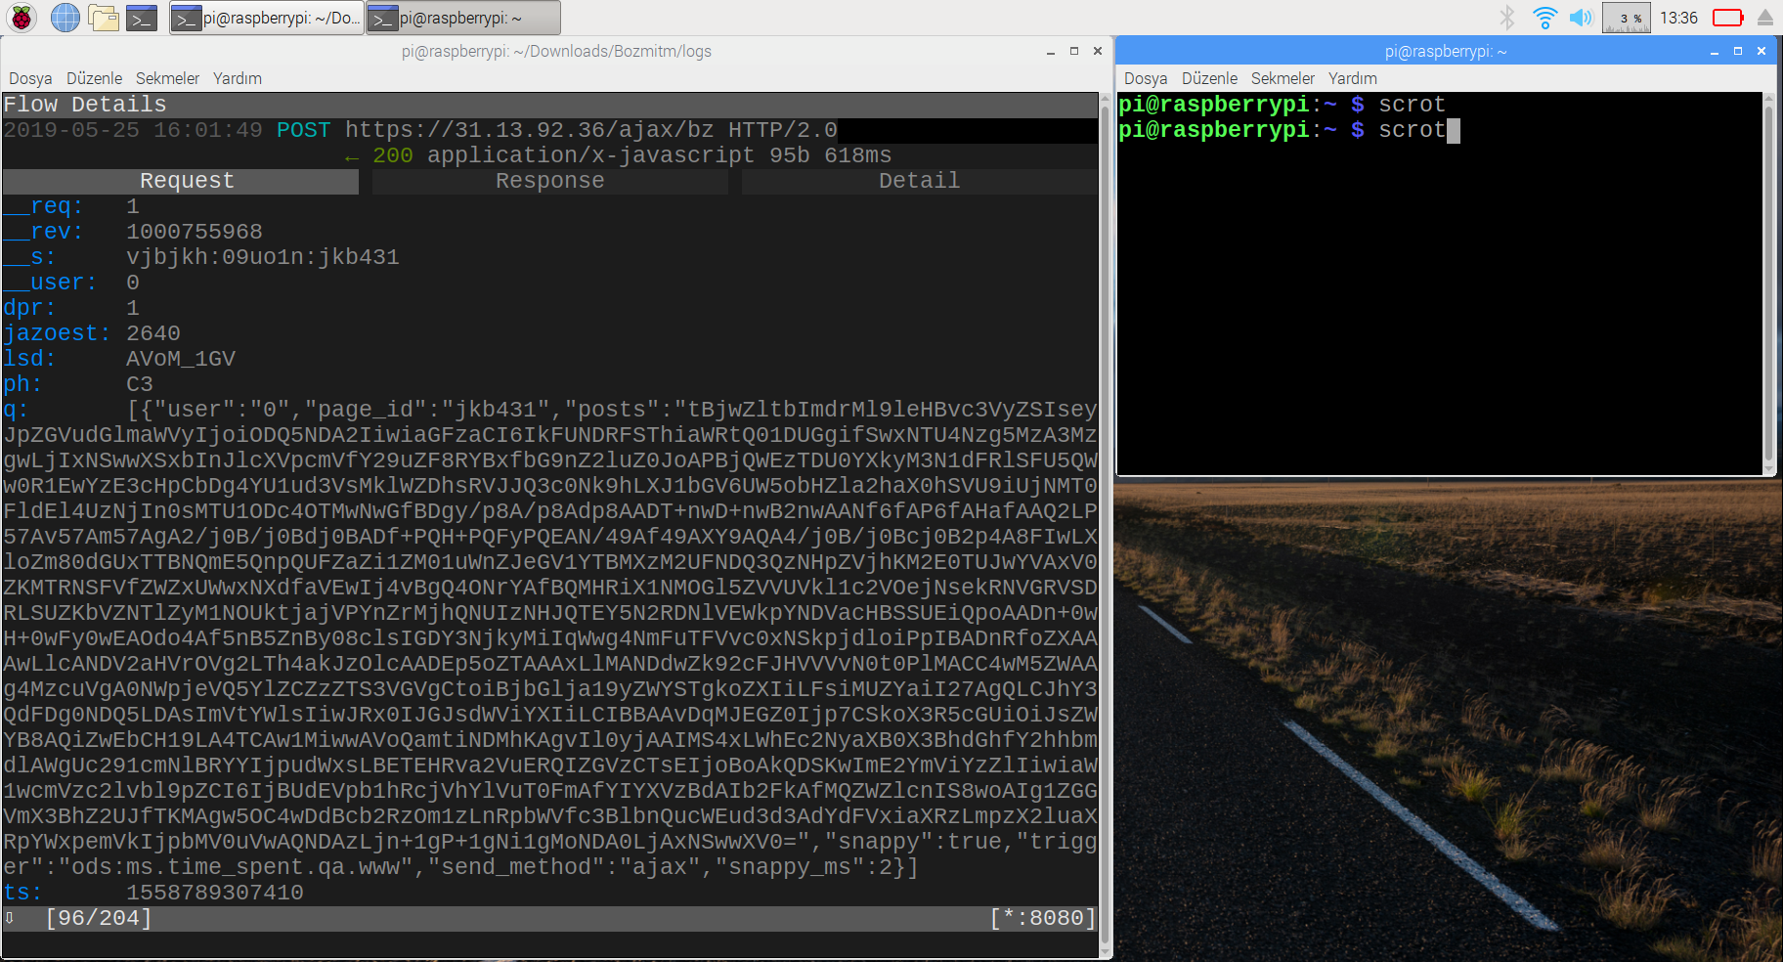

Slide 20
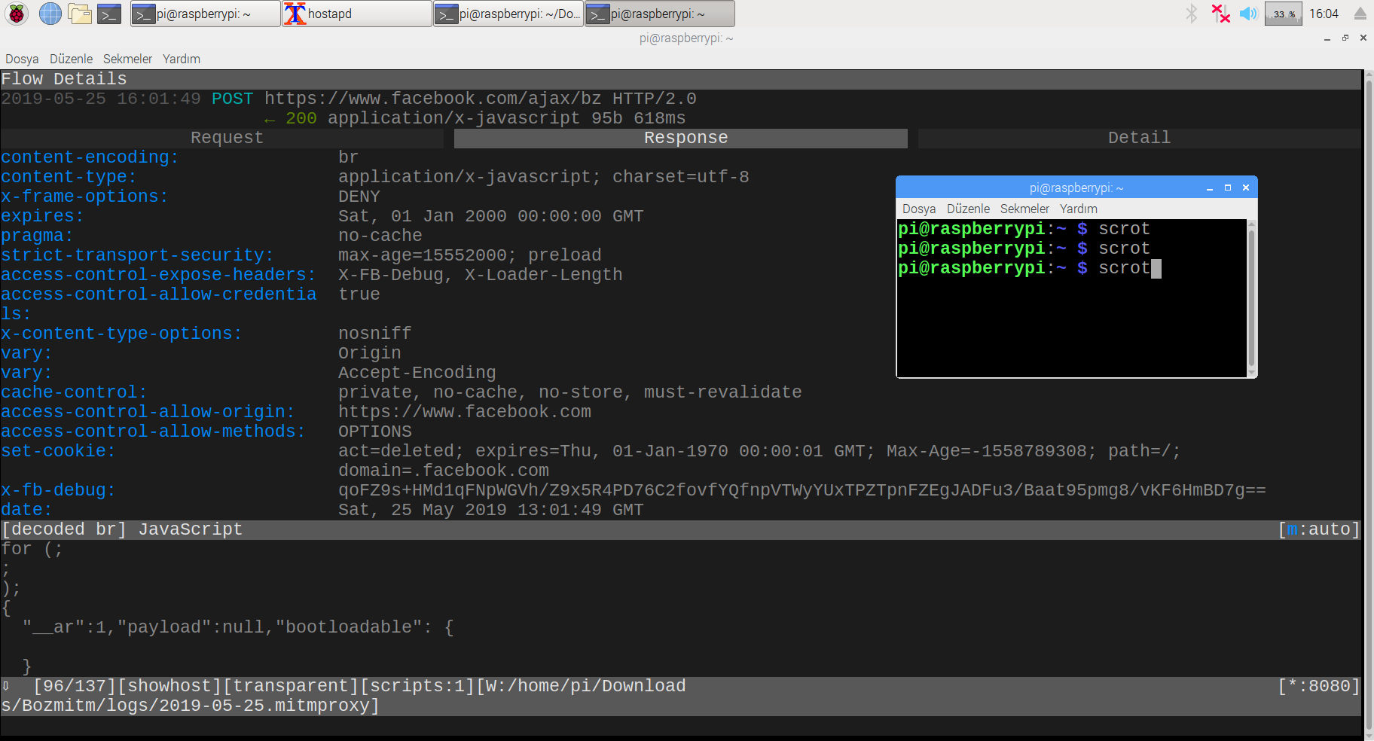

Slide 21
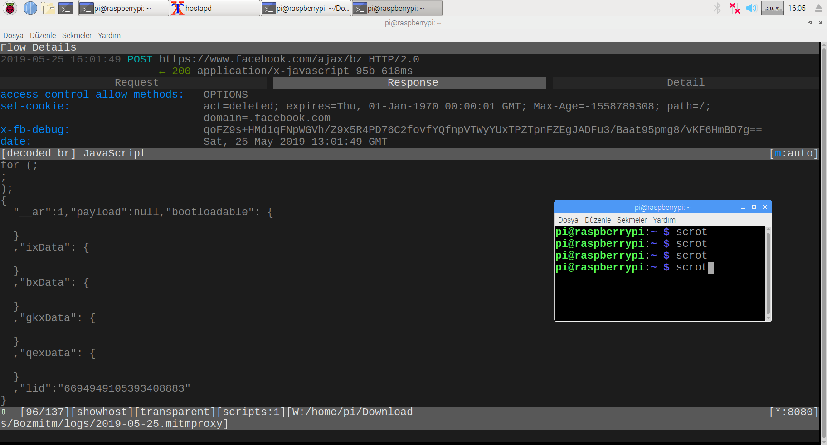

Slide 22
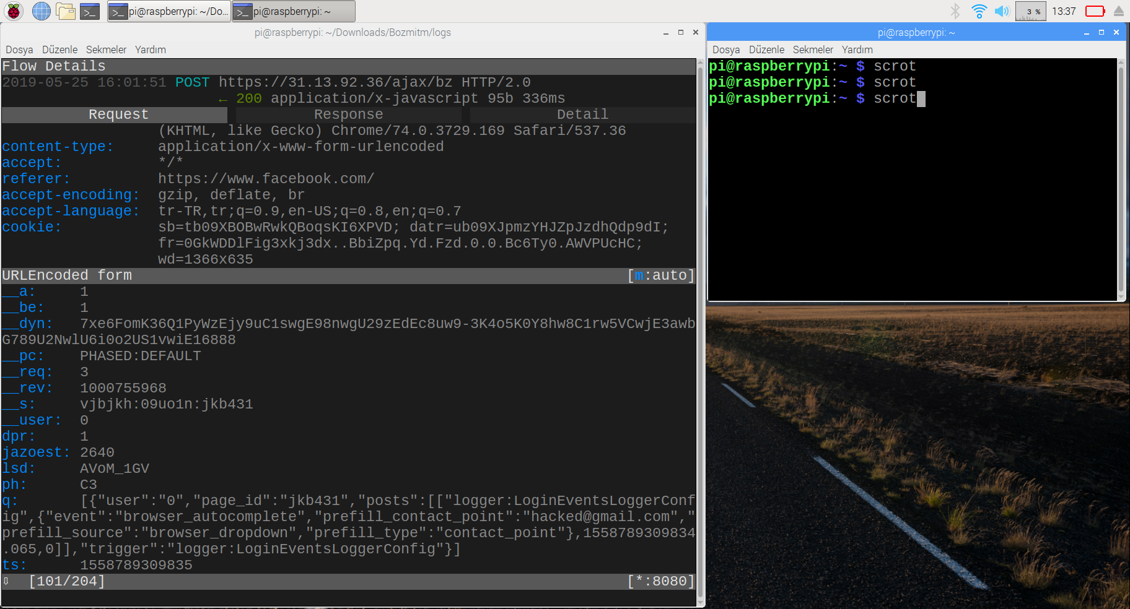

Slide 23
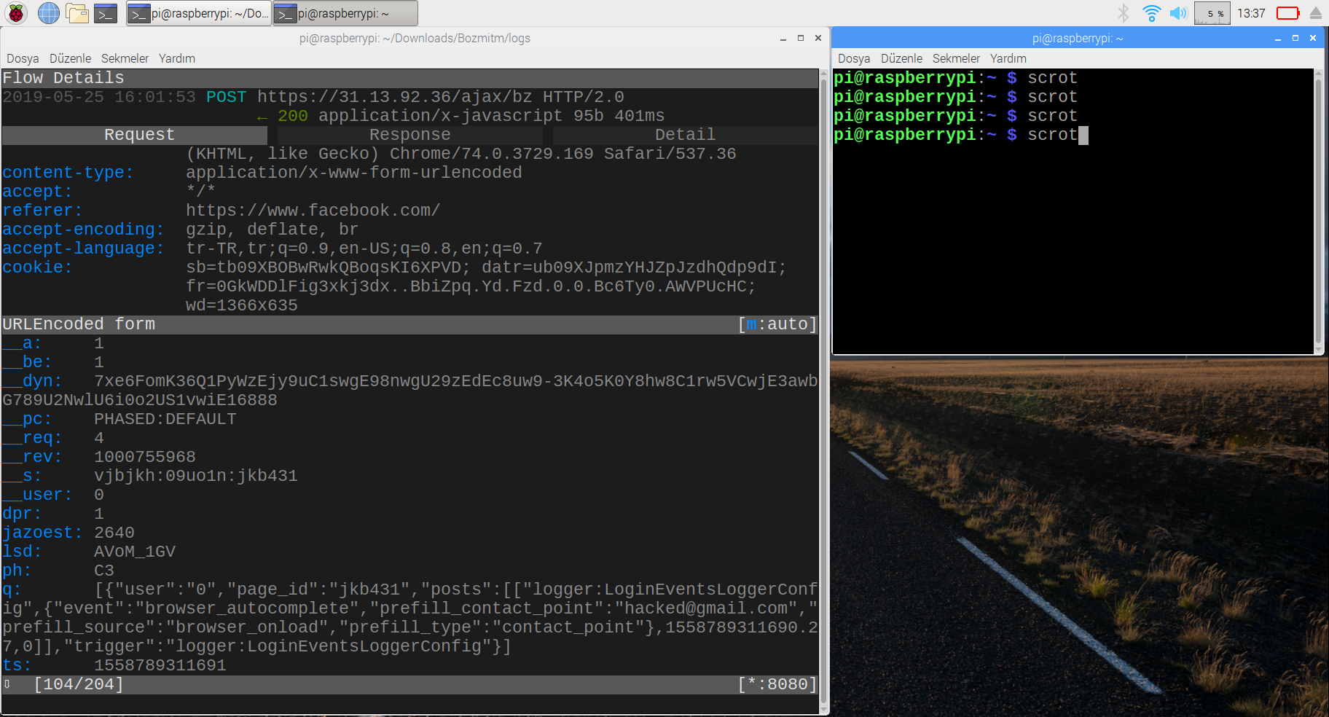

Slide 24
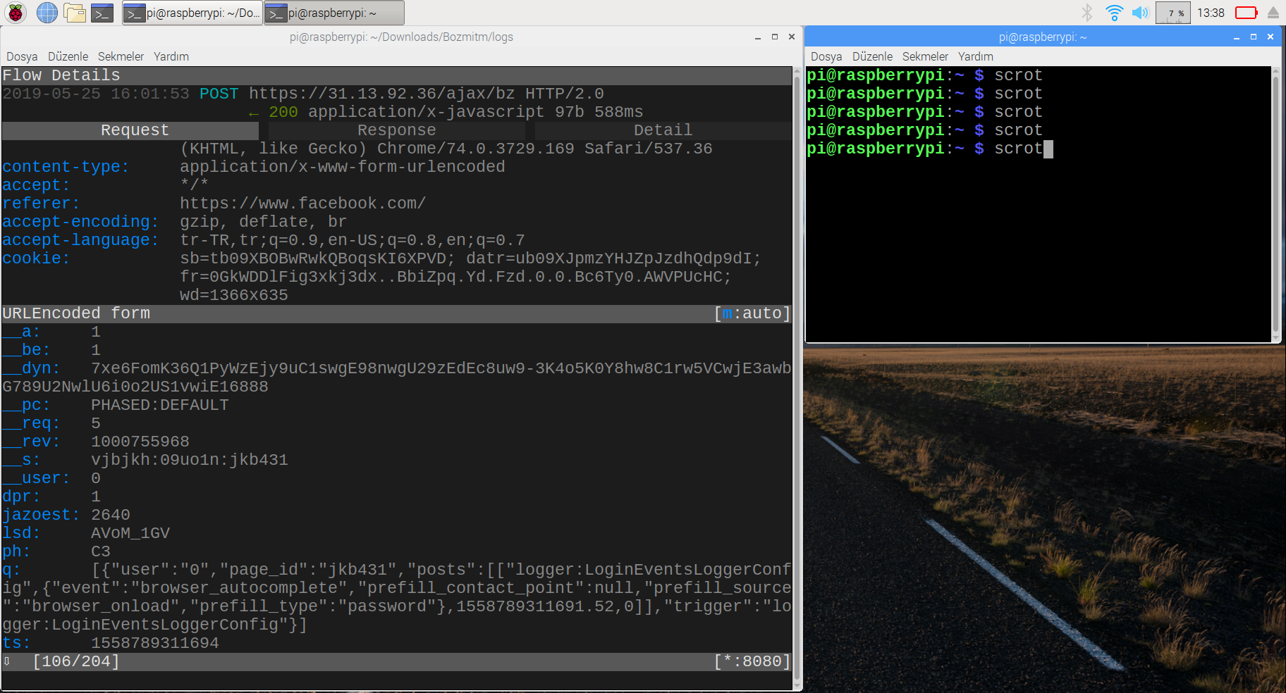

Slide 25
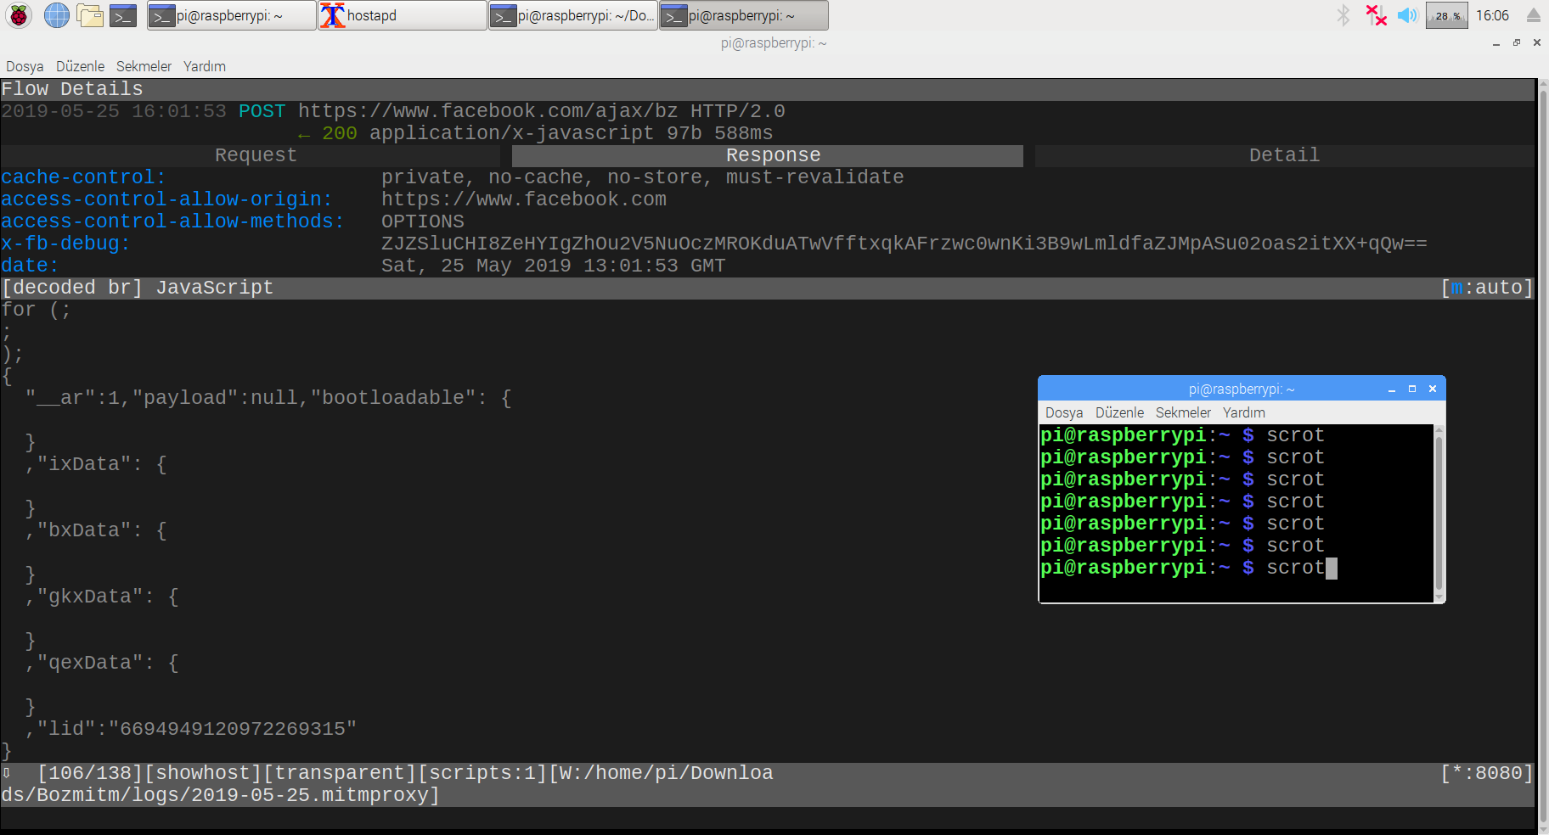

Slide 26

Cookie

Slide 27
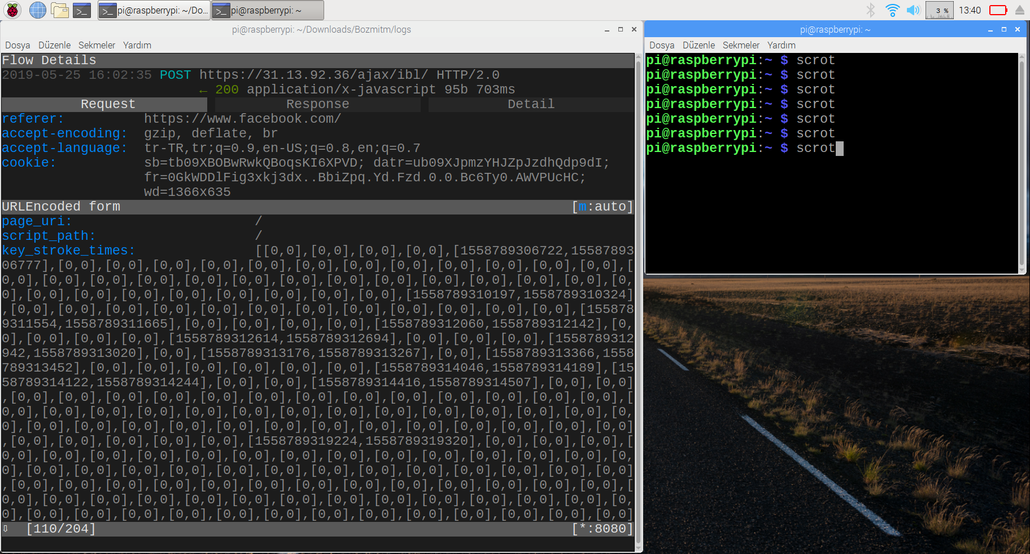
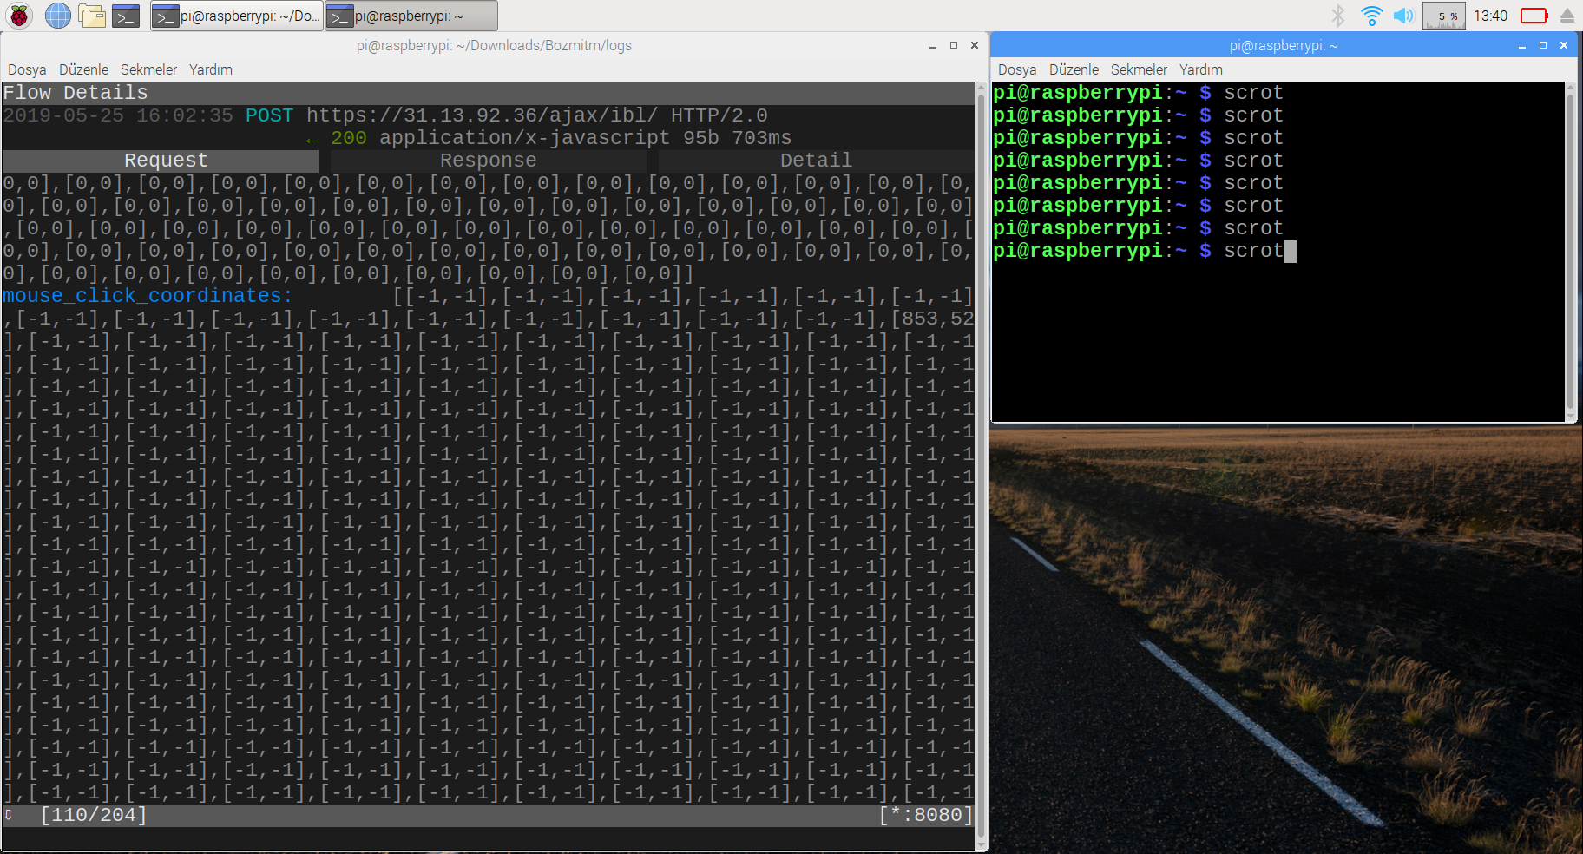
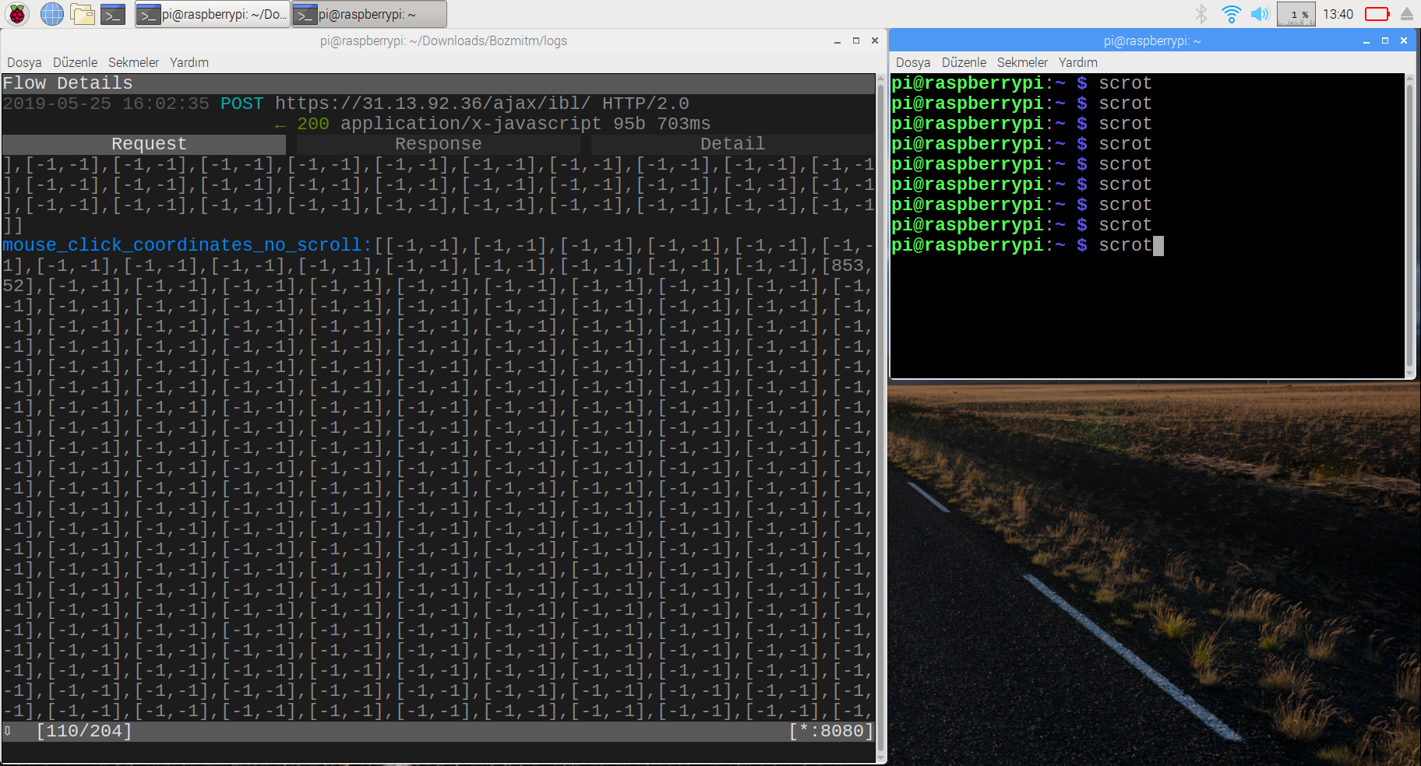
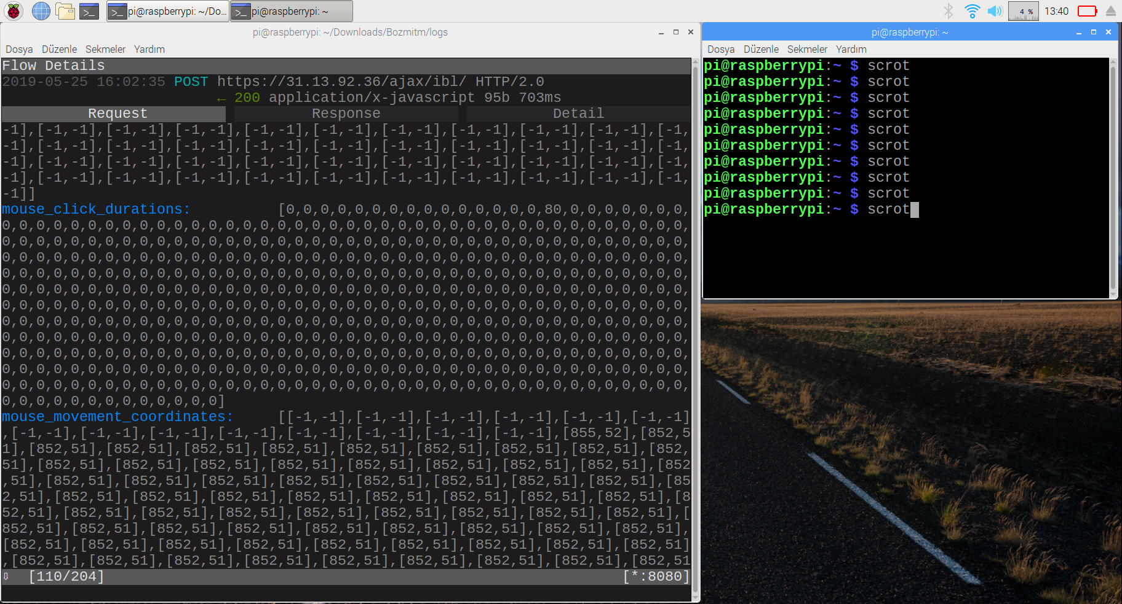
Facebook posting mouse coordinates

Slide 28
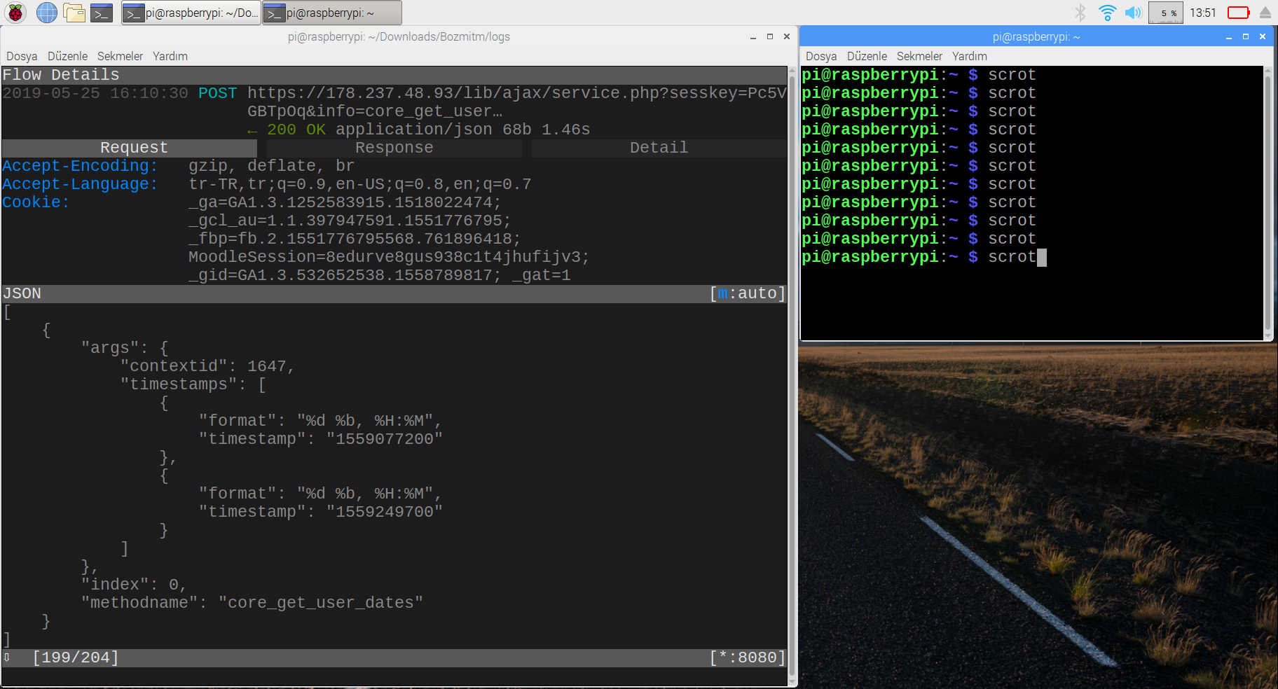
LMS post

Slide 29
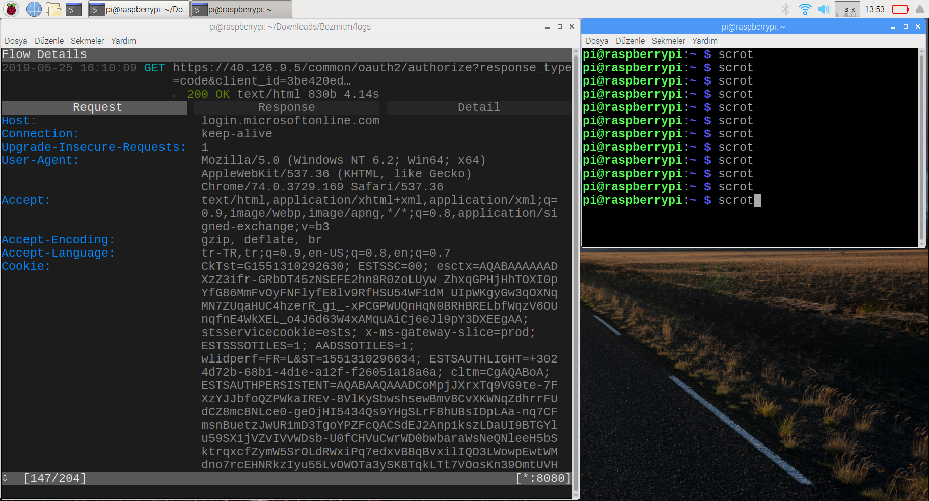
LMS auth

Slide 30
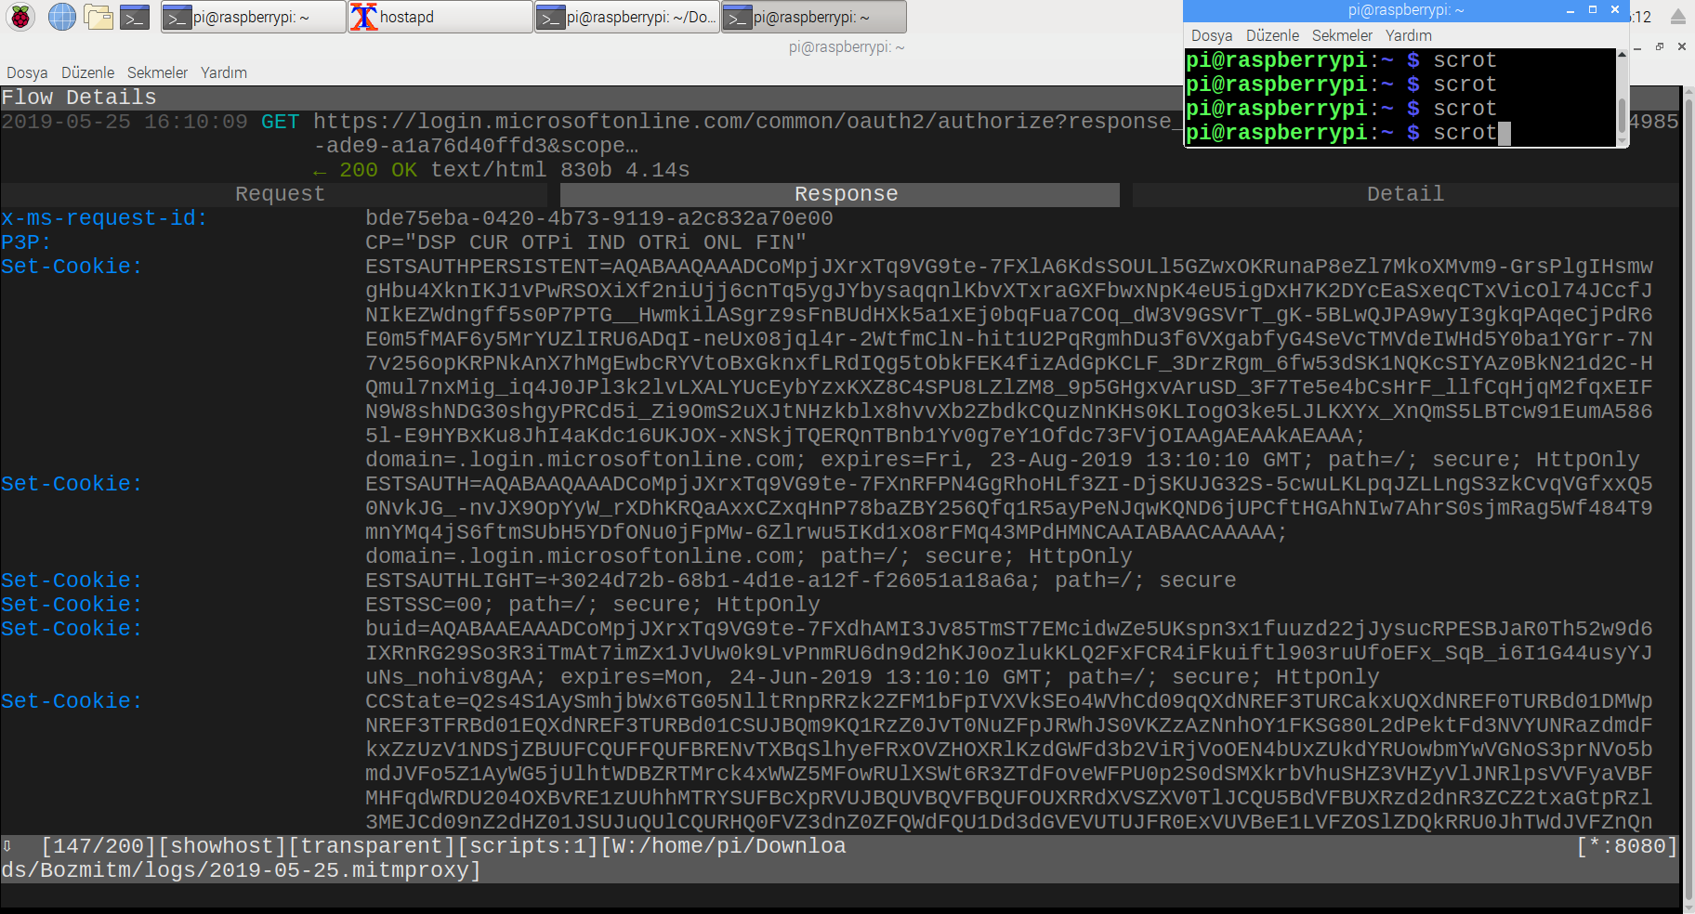
LMS auth

Slide 31
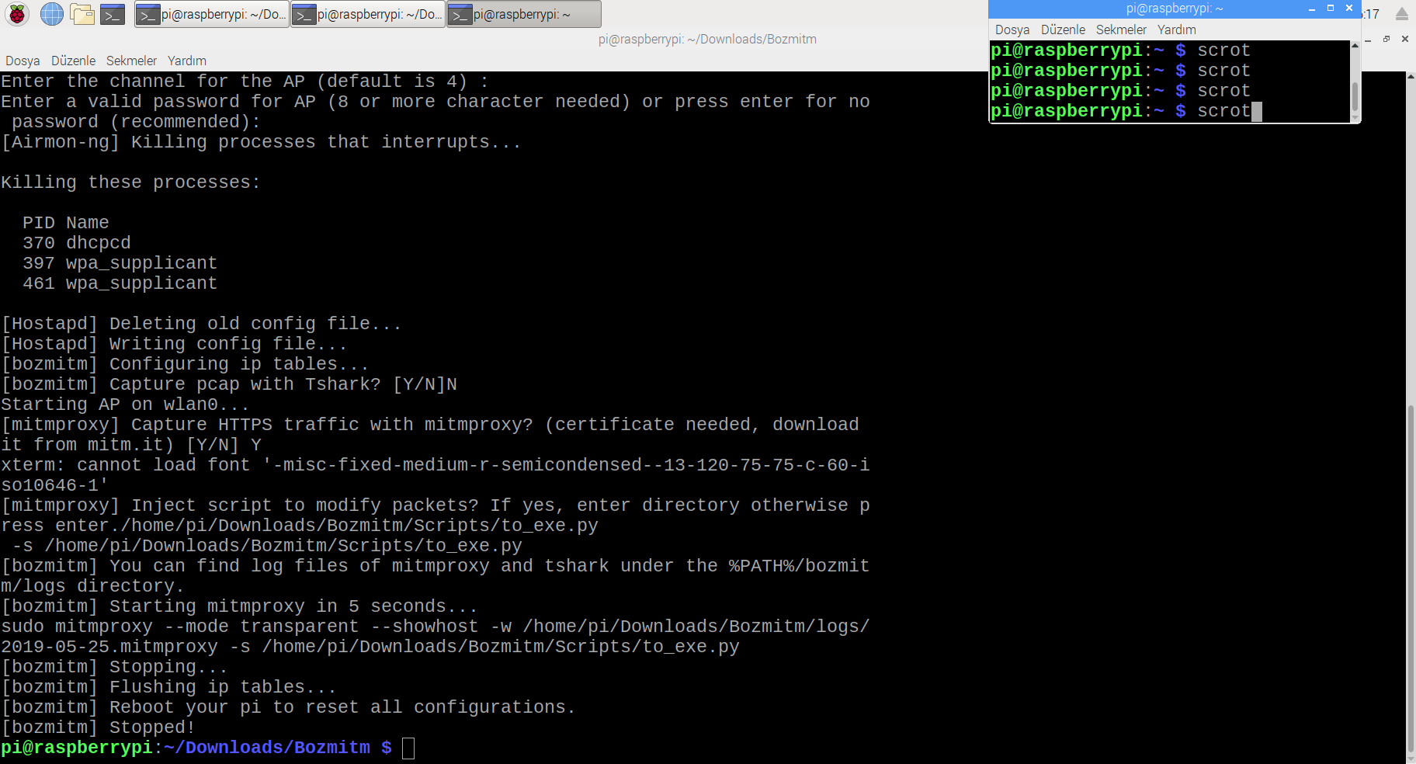
The End
Barış Özbaş
S014669
https://github.com/barisozbas

